Slide 1

Ergonomics Semester 2 Week 9

Slide 2
What had been discussed last week
Design an algorithm to handle stress, cumulative damage, and risk
Look for the shoulder information from 3dsspp research paper

Slide 3
Timeline
Content | Date | Progress
Learning Basics of Deep Learning | Sep 2022 | Done
Installing Alphapose/Openpose/VideoPose3D | Sep-Oct 2022 | Done
Learning Ergonomics Basics | Oct-Nov 2022 | Done
Forming a Framework of Time Continuous Cumulative Fatigue
Preparing for Final Exam | Nov-Dec 2022 | Done
Review the Time Continuous Cumulative Fatigue Framework | Dec 2022 | Done
Trying to Extract Coordinates Using Alphapose/Openpose | Dec 2022
Adding on a Cumulative Fatigue Assessment using Alphapose/Openpose with Python | Jan-Mar 2023
Writing a Technical Report for our Research | Mar 2023

Slide 4
How to Obtain Ultimate Strength Percentage, S
Low Back
US_axial = 6000N
US_bending = 51.7 Nm
F
S_bending =
M
S_axial =
US_axial
US_bending
S = a * S_axial + b * S_bending
Shoulder
US_axial = ?
US_bending = ?

Slide 5
How to Obtain Ultimate Strength Percentage, S (Reviewed Version)
Low Back
σ_bending =
My
US_back = 6000N
I
σ_bending * A=
My * A
I
F ’ =
a
M + b
F + F ’
S =
US_back

Slide 6
How to Obtain Ultimate Strength Percentage, S (Reviewed Version)
Shoulder
σ_bending =
My
US_shoulder = 115N
I
σ_bending * A=
My * A
I
F ’ =
c
M + d
S =
F + F ’
US_shoulder

Slide 7
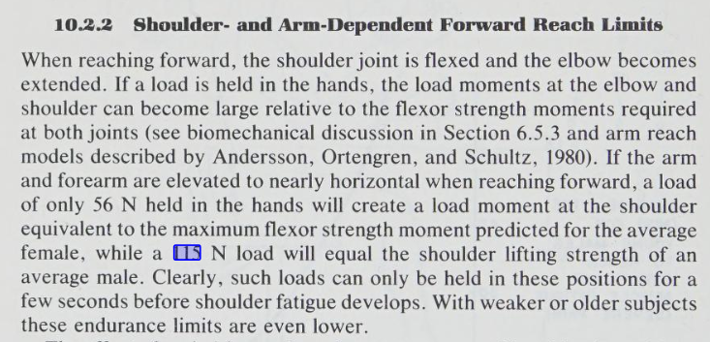
How to Obtain Ultimate Strength Percentage, S (Reviewed Version)
Occupational Biomechanics pg. 392
*** But human shoulders can carry the load with the weight above 115N load, thus it doesn’t make sense

Slide 8
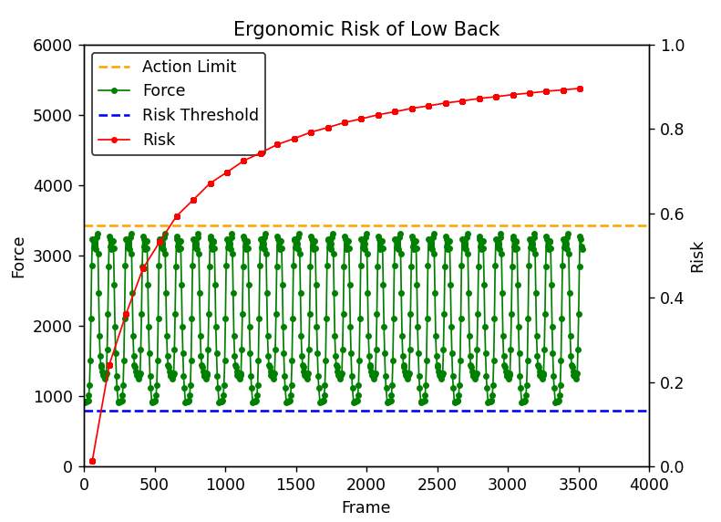
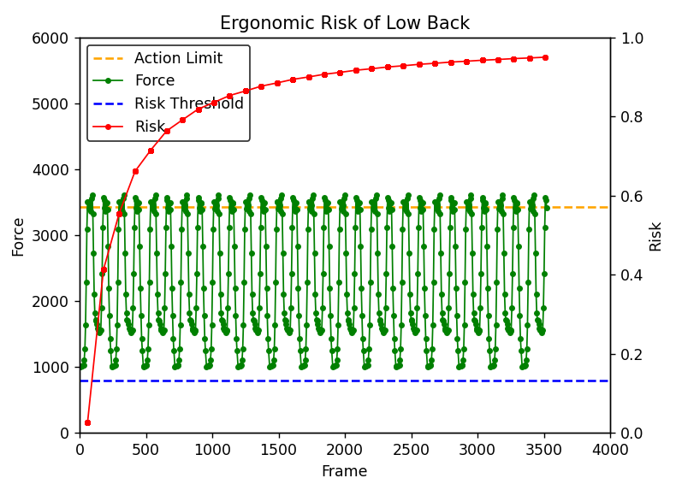
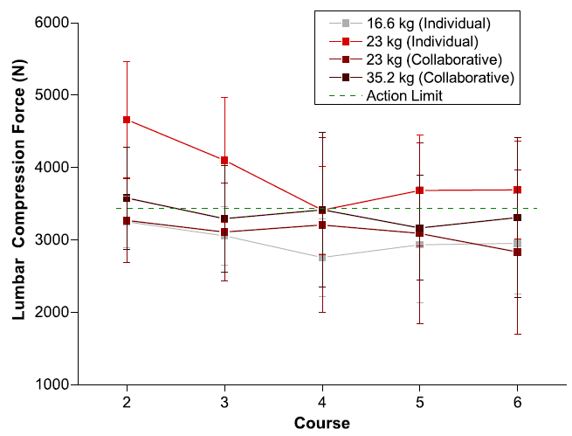
How to Obtain Ultimate Strength Percentage, S (Reviewed Version)
a = 10
Body weight = 600N
Repetition = 30
Load = 166N
a = 10
Body Weight = 600N
Repetition 30
Load = 230N

Slide 9
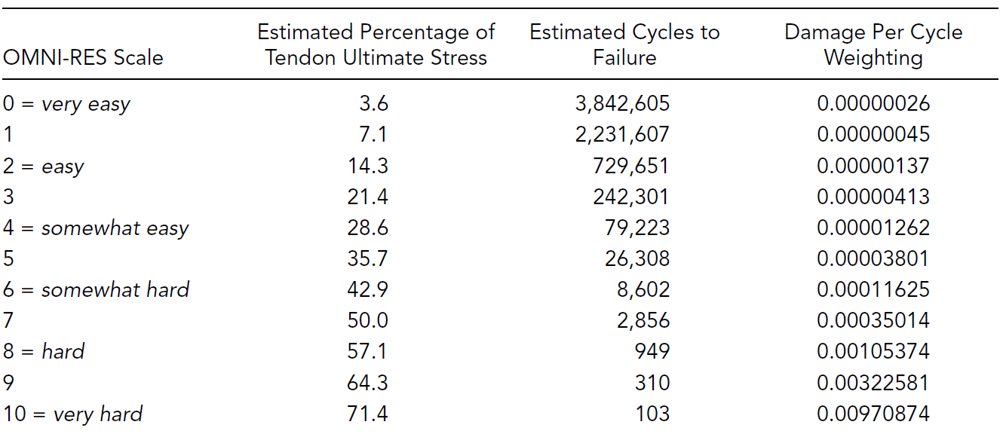
Difficulties for Shoulder Risk
More forces need to be consider (tensile force, compressive force, shear force), each force has different direction.
The current research doesn’t have a golden standard for the maximum acceptable force for all the 3 directions. Current way to deal with shoulder risk is as shown in the figure below, we need to somehow apply a qualitative way (select a category) for the first step
Even though we can find, the data doesn’t make sense to us.
Due to the time limitation and the complexity, I suggest we can just focus on the low back risk at this stage.

Slide 10
Challenges of This Week
Couldn’t find useful information for shoulder

Slide 11
Next Meeting
URECA Video
Research Paper
Data Collection
Judge the result in a qualitative way (common sense) and quantitative way( film another video with correct posture)

